Slide 1

Project Quack
Presented by
The Bestagons
Notes:
David

Slide 2

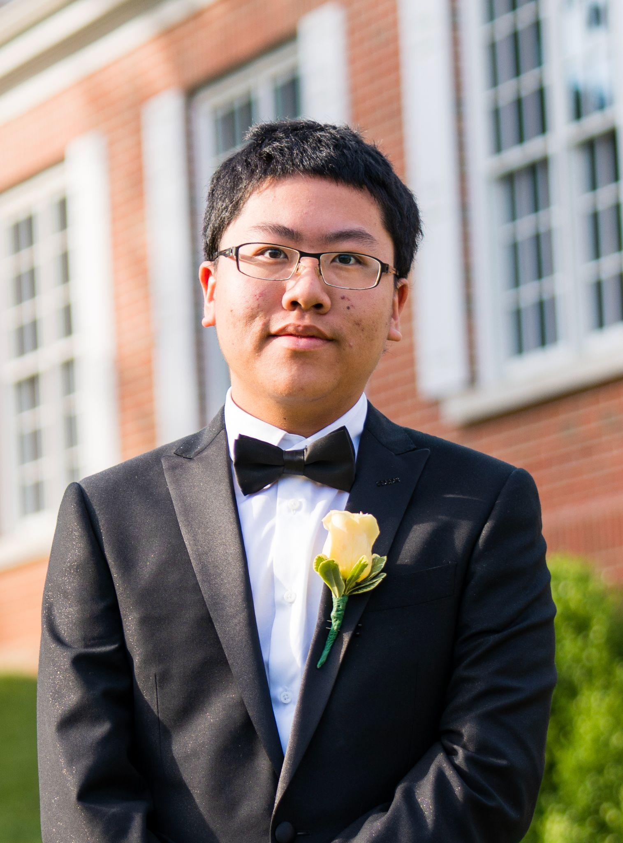

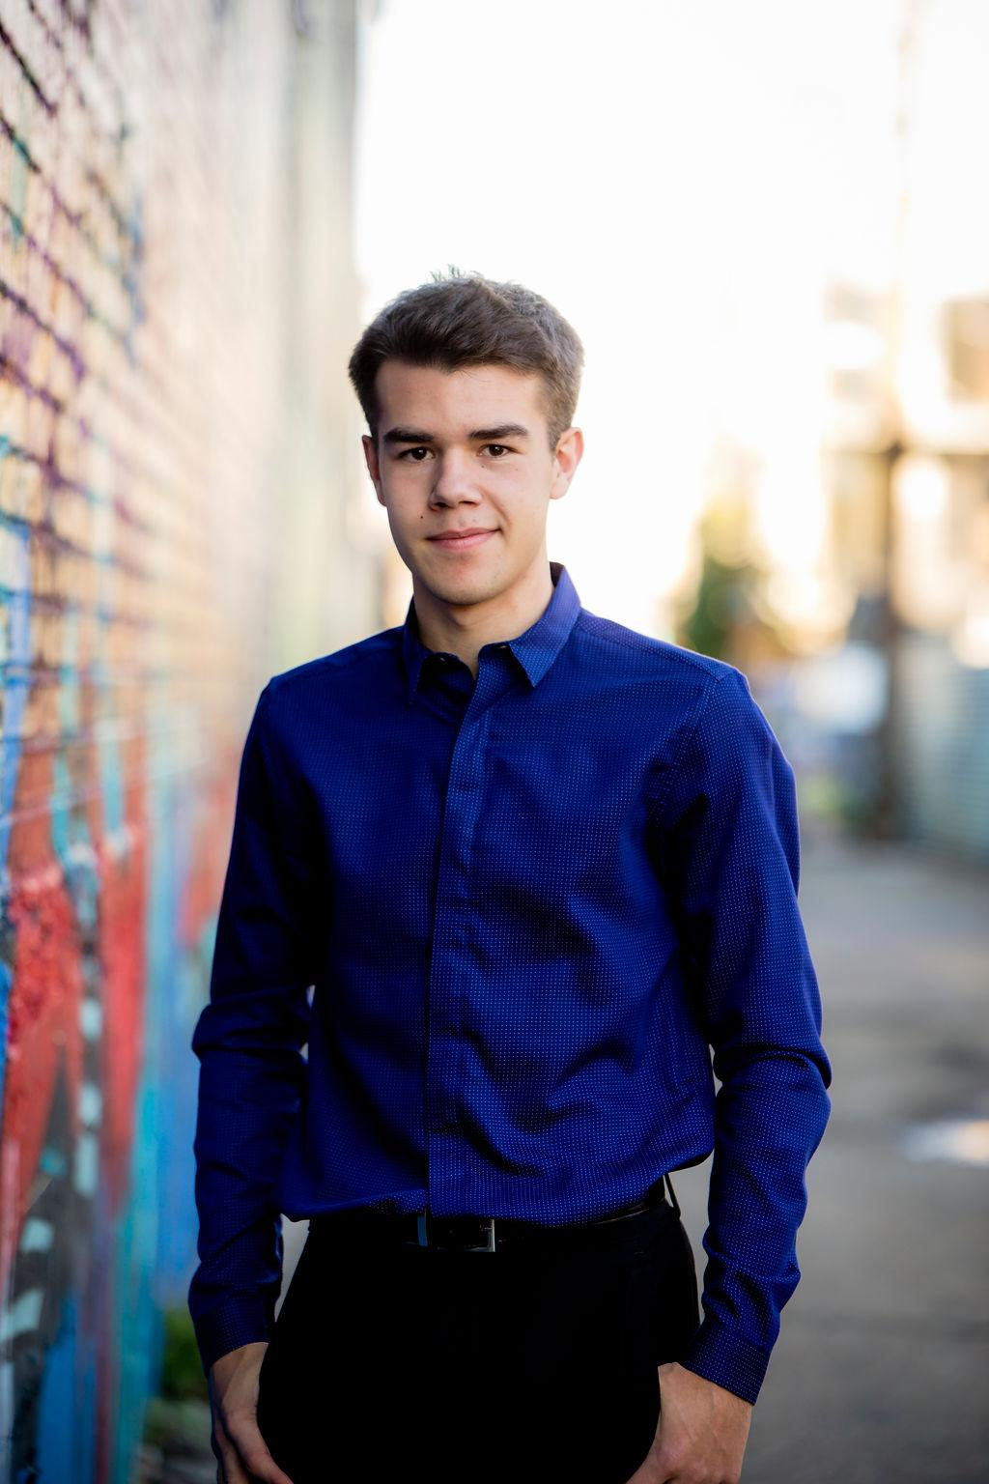
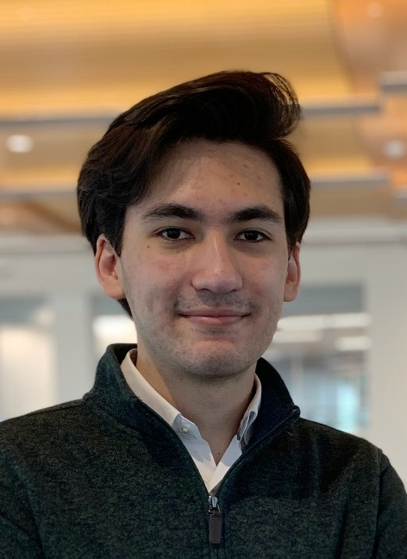
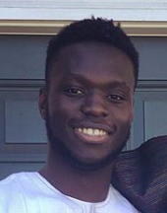
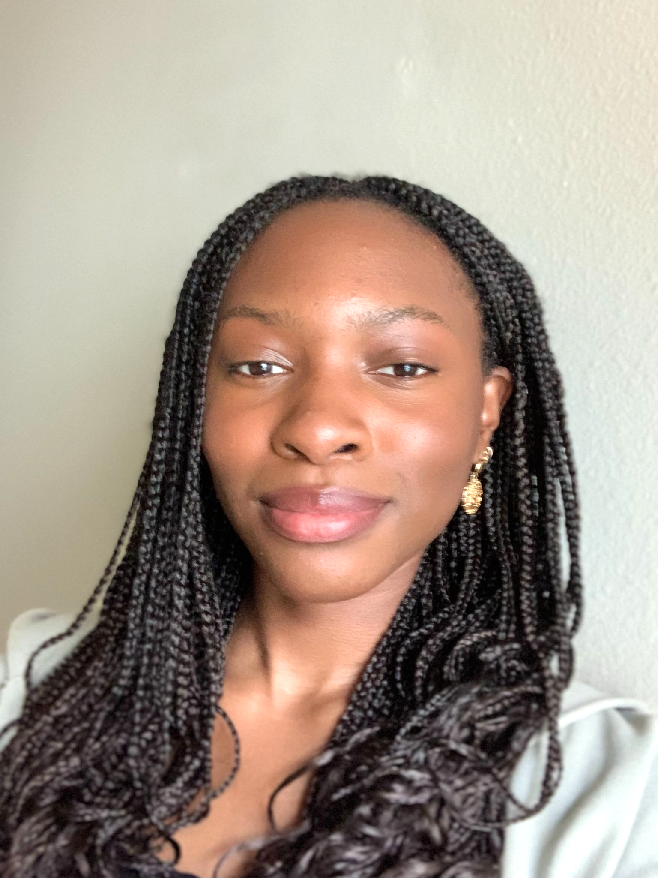
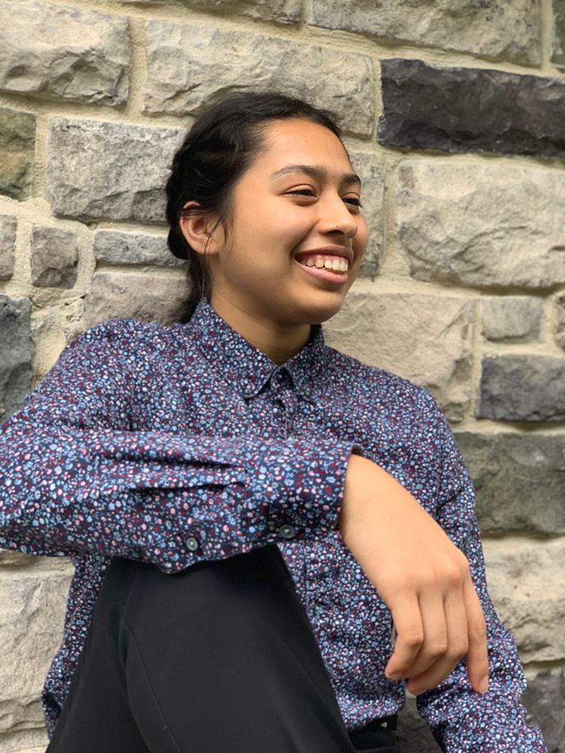
OUR TEAM
Miles Robertson
Rafael Piloto
Ore Adenikinju
Mimi Olayeye
Brenda Cano
David Wei
Product Owner
Scrum Master
Team member
Team Member
Team Member
Team member
Notes:
David

Slide 3
AGENDA
01
03
02
Acknowledging Feedback
What are our goals for the week?
What did we accomplish?
Notes:
David

Slide 4
01
Acknowledging Feedback
Notes:
Rafael

Slide 5
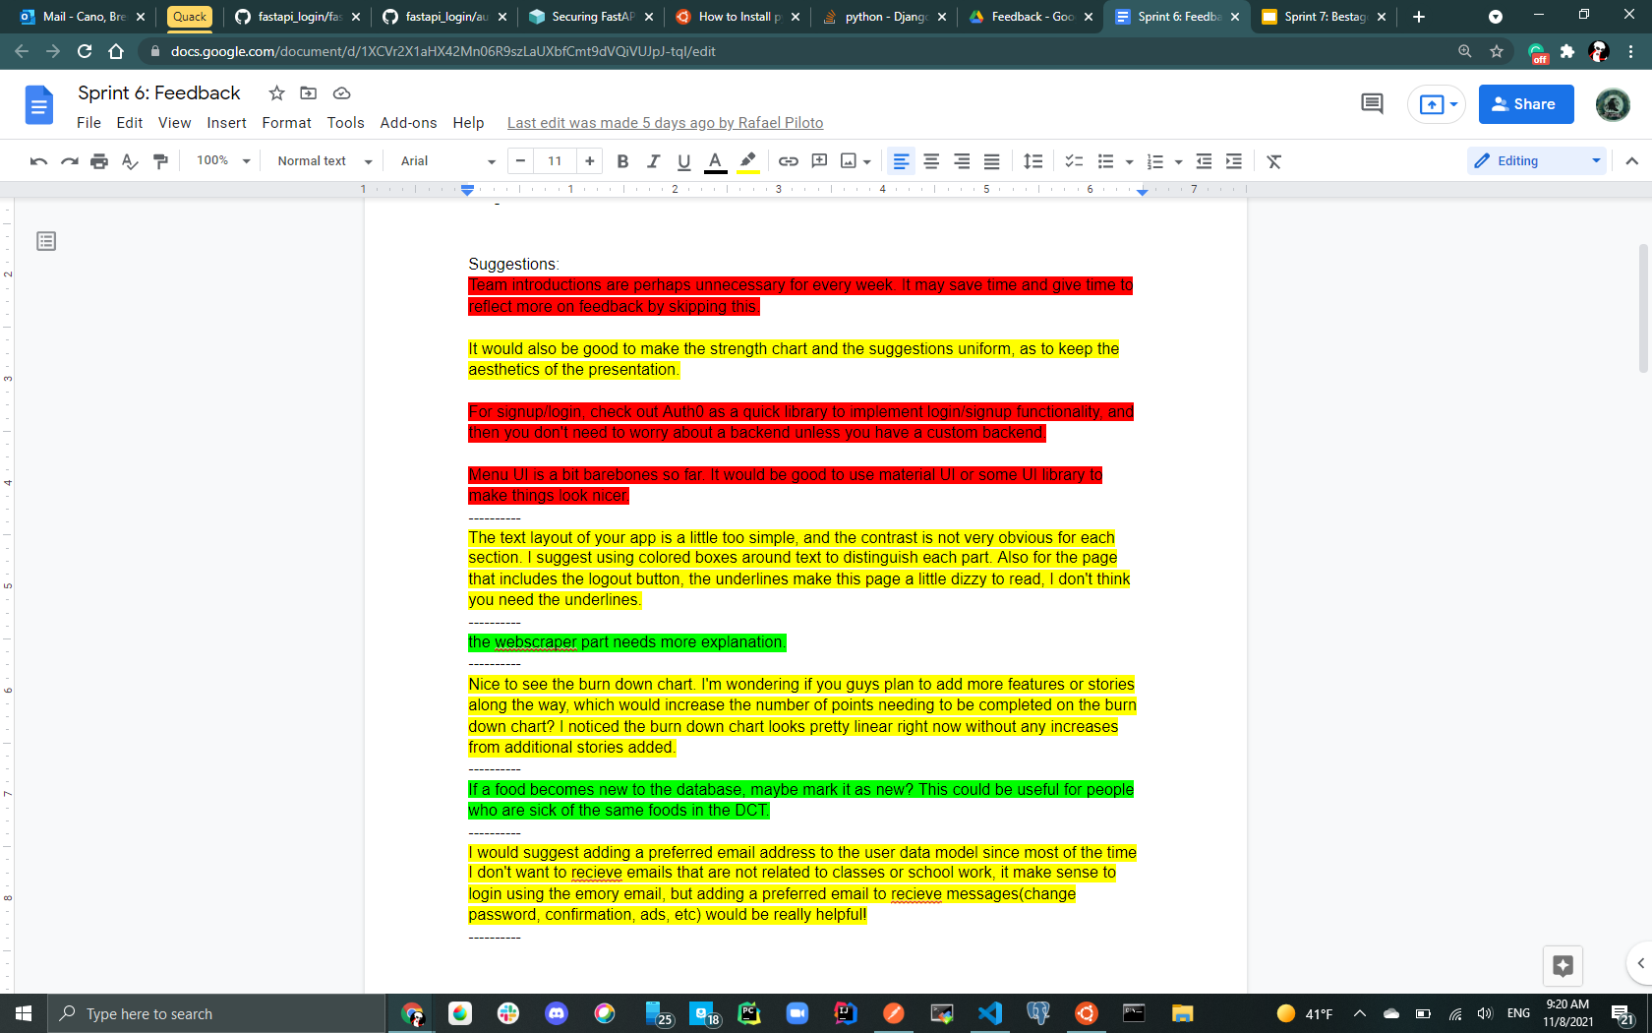
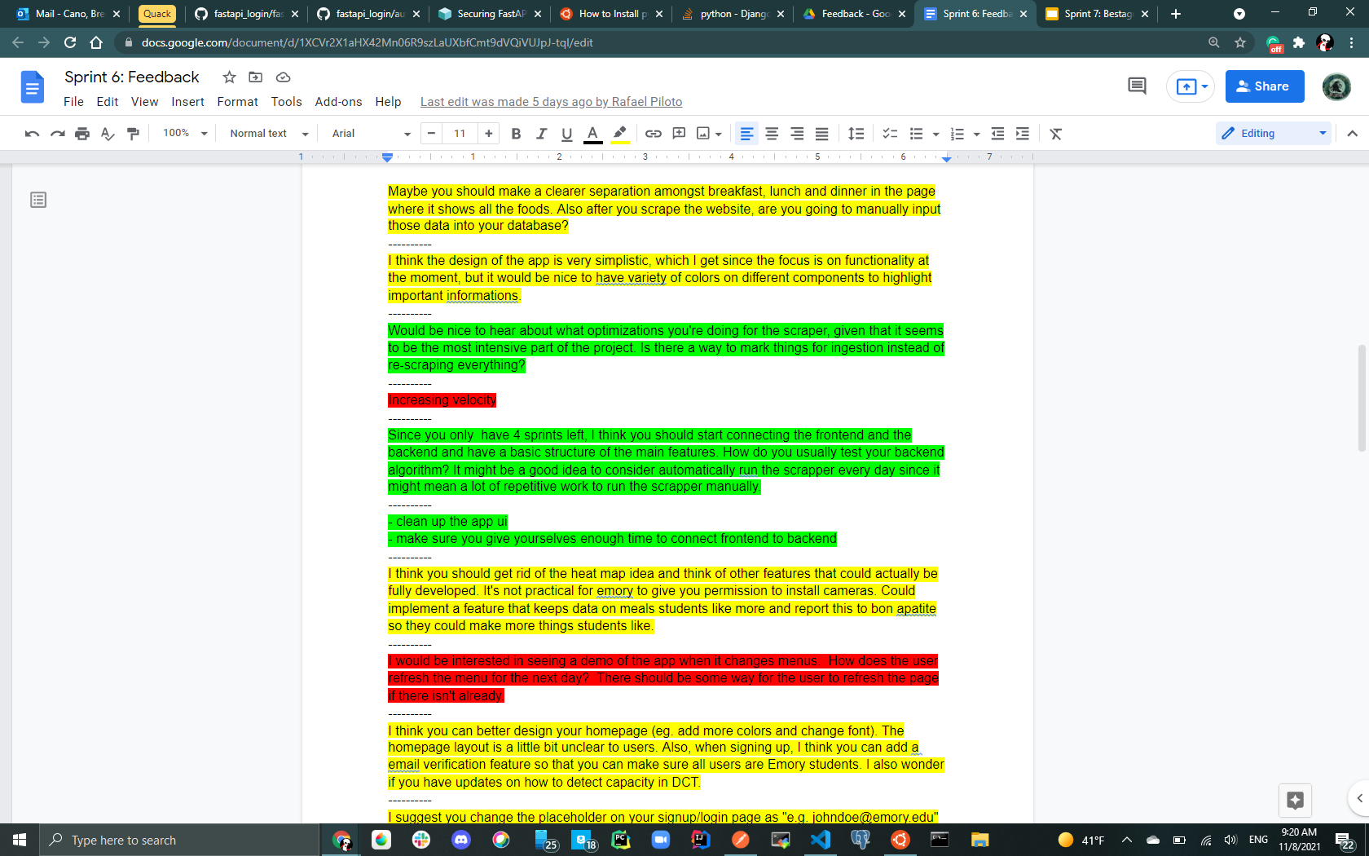
Example of how we looked through feedback this sprint
Notes:
Rafael

Slide 6
UI
Too monotonous/simplistic
Needs to be cleaned up
Frontend + Backend*
Need to start connecting the frontend with backend
*Already started working on this, will be discussed in 02: What did we accomplish?
Notes:
Brenda

Slide 7
Changes in UI
We want to improve our UI and this will be done throughout the next few sprints as we do final touches
Constraints:
We hope to keep the color scheme simple to not overwhelm the user
Ideas we had in mind:
Add shading to buttons, banners, titles
We ask you include specific feedback for what you think will improve our app UI with the above in consideration
Notes:
Brenda

Slide 8
02
What did we accomplish?
Notes:
Miles

Slide 9
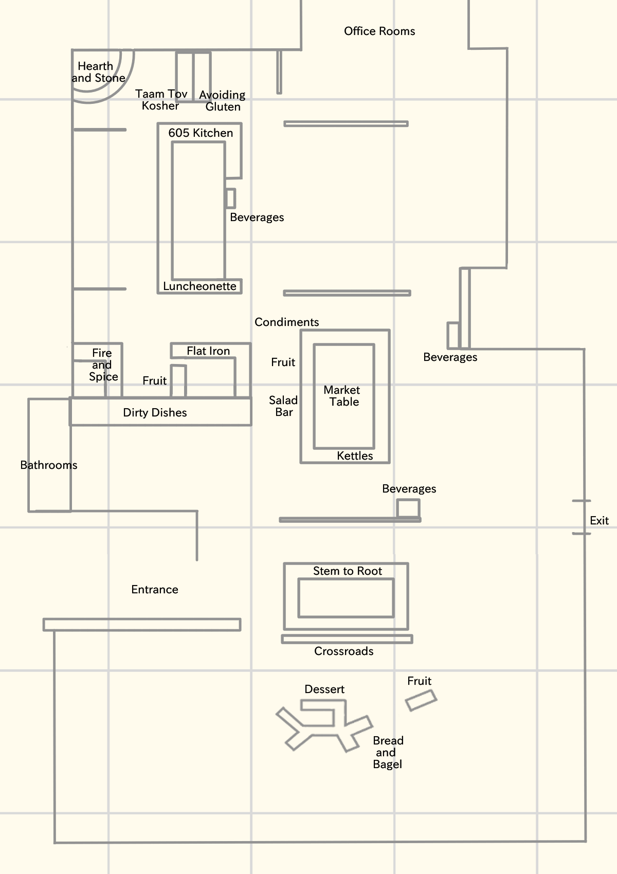
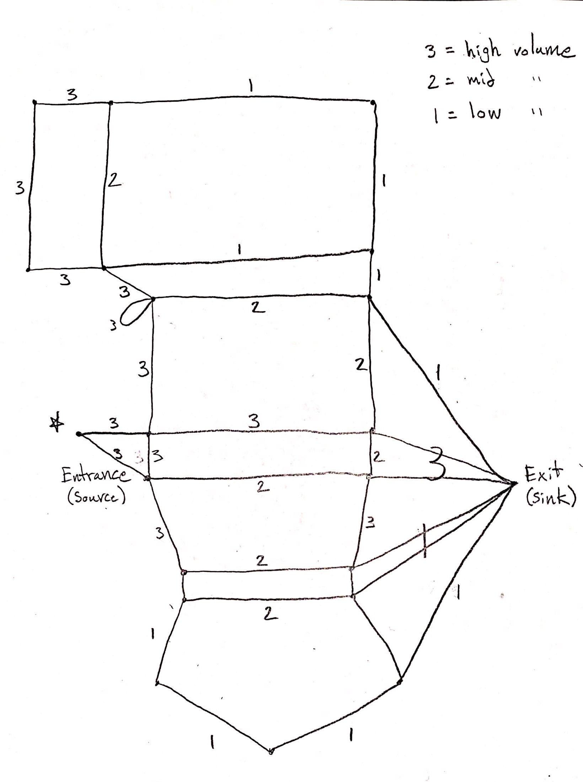
Notes:
Miles

Slide 10

Notes:
Miles

Slide 11
Notes:
Miles

Slide 12
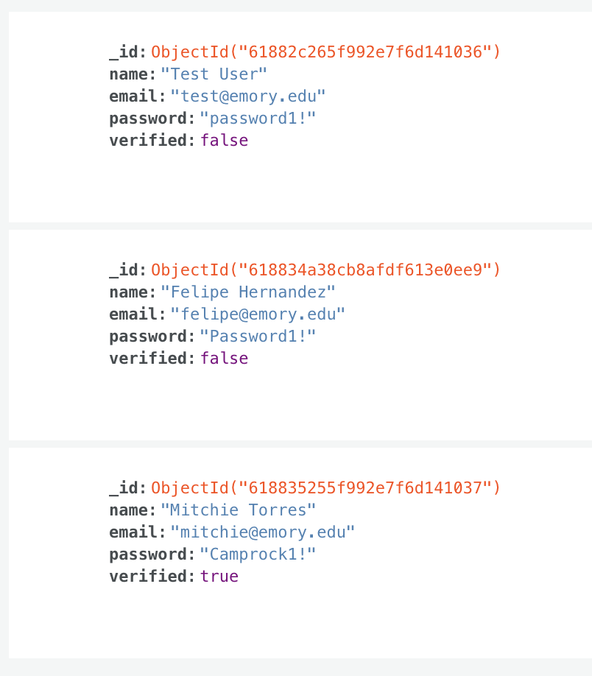
Login/Registration
Connection
Connected Login & Registration with backend
Saves user data in Database
Completed unit tests
Notes:
Rafael

Slide 13
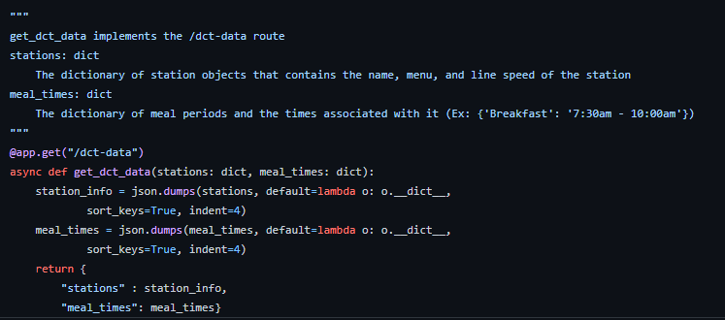
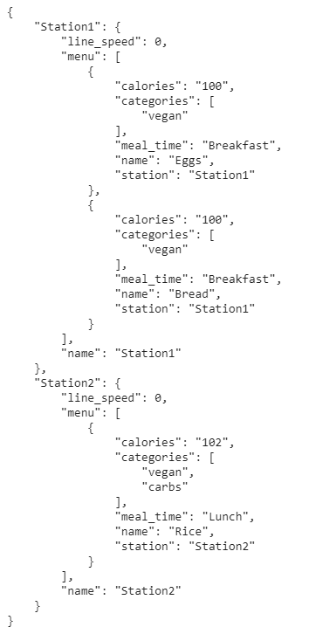
Connecting DCT Backend Data to Frontend
Converting station dictionary and meal time diction into JSON objects
Still in the process of refactoring code on the frontend to sync properly with backend code
Notes:
Ore

Slide 14
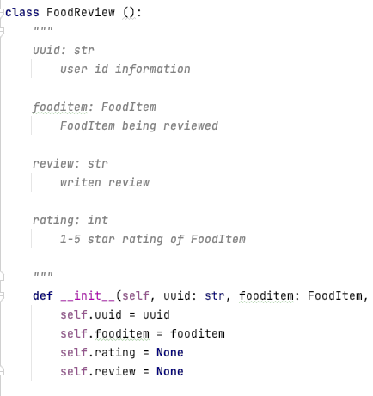
Backend (Food Reviews)
Working on the implementation of food reviews for the backend
Users can add rating and reviews for the meals at the DCT
Next: Connecting to FastAPI
Notes:
Mimi

Slide 15
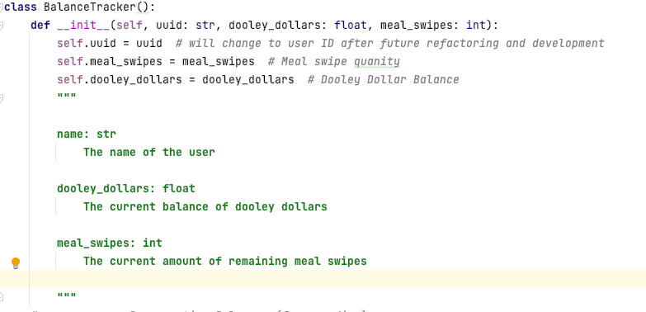
Backend (Balance Tracker)
Completed the implementation of the Balance Tracker Class
Keeps an updated record of the users doodley dollar and meal swipe balance
Next: Connecting to FastAPI
Notes:
Mimi

Slide 16
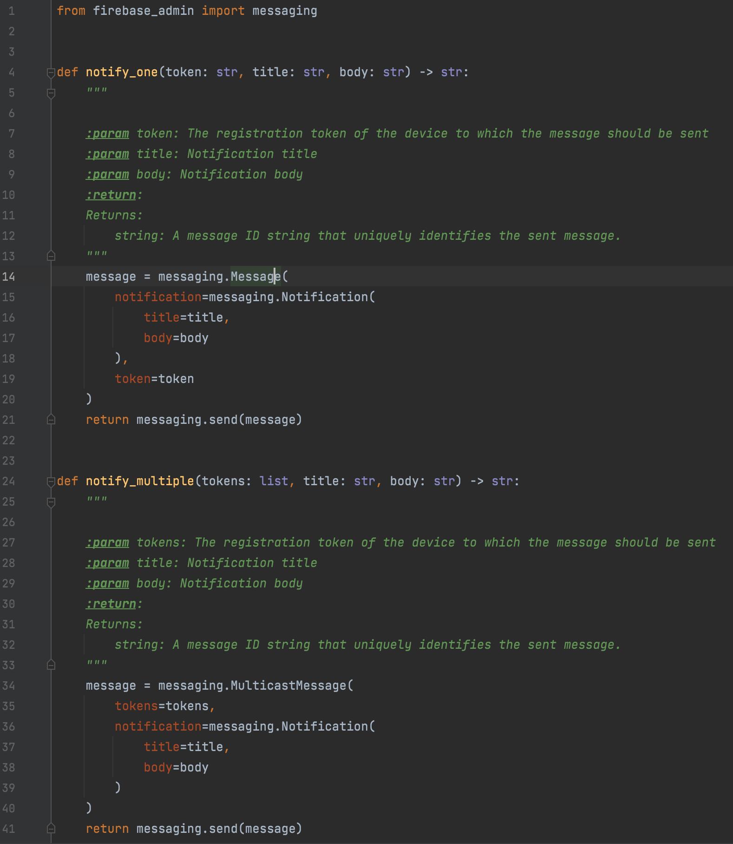
Backend (Push notifications)
Used firebase to handle push notifications
Implemented notify one & notify multiple
Notes:
David

Slide 17
03
What are our goals for the week?
Notes:
Miles

Slide 18
11 points
Ahead of schedule!
Notes:
Miles
YAY

Slide 19
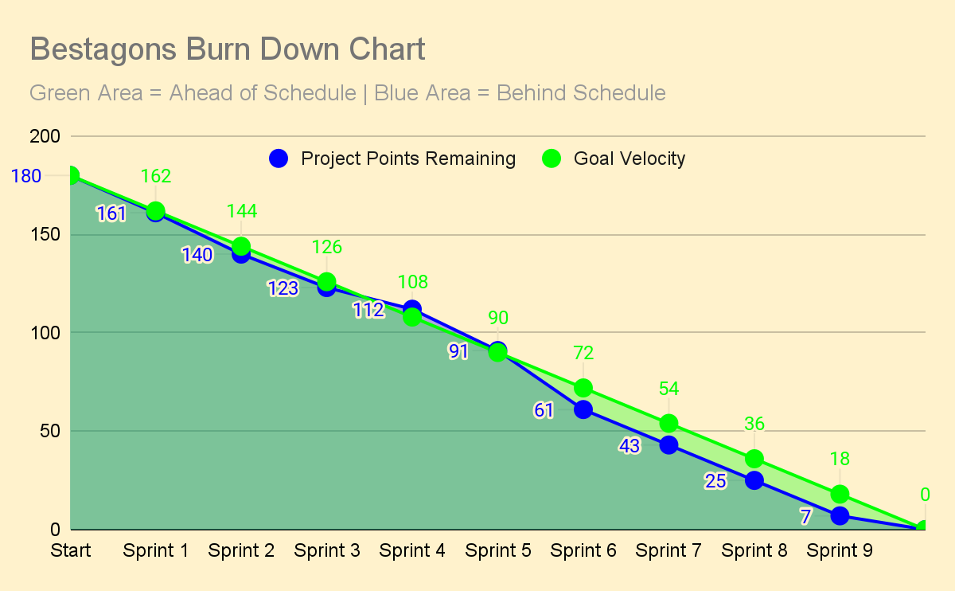
Notes:
Miles
Keep working ahead so that we can mostly take off Sprint 10 for Break

Slide 20
THANKS
Please remember to share your feedback :)
Notes:
Miles

